Slide 1
City Management Systems
SlideMake.com

Slide 2
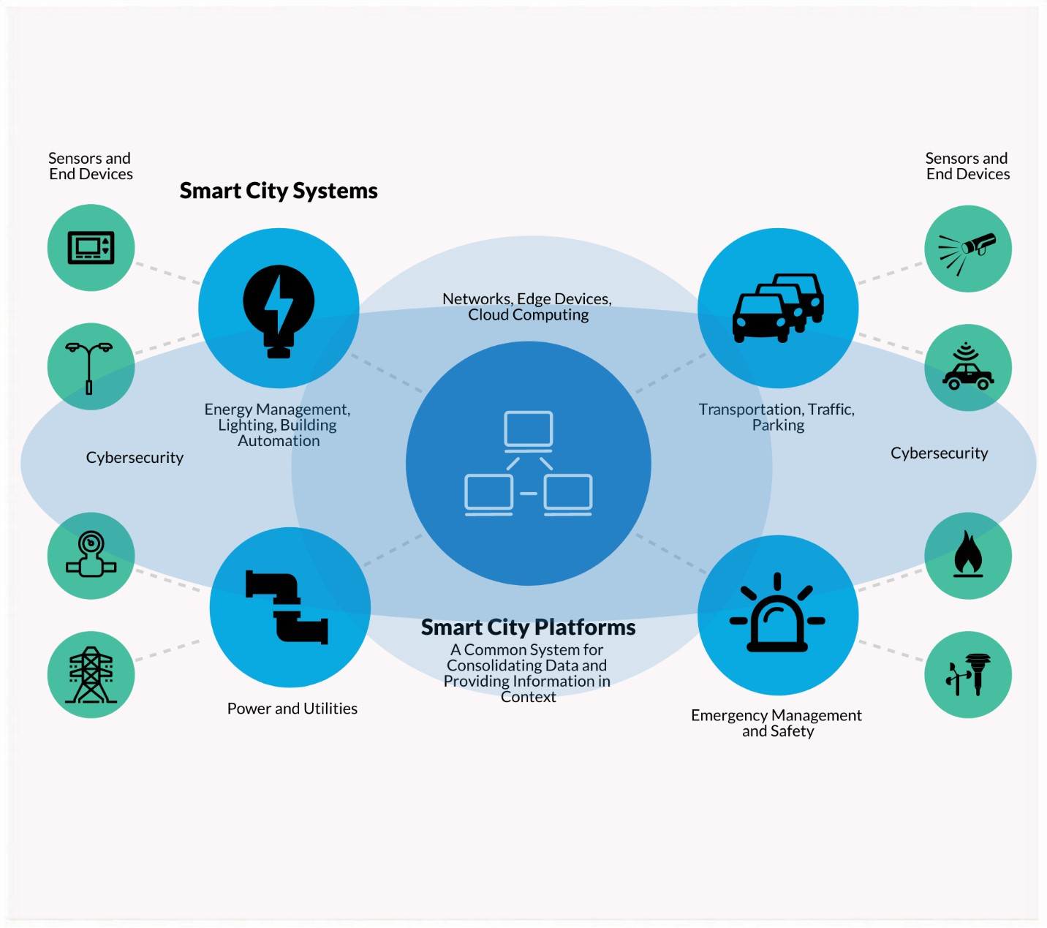
Introduction to City Management Systems
City Management Systems are software platforms used by municipalities to streamline operations and improve efficiency.
These systems typically include modules for finance, human resources, planning, and public works.
Implementing a City Management System can lead to cost savings, better decision-making, and enhanced citizen services.
Notes:
Image source: https://www.arcweb.com/blog/what-smart-city-platform

Slide 3
Benefits of City Management Systems
Improved transparency and accountability in government operations.
Enhanced data accuracy and accessibility for decision-makers.
Increased efficiency through automation of processes such as permit approvals and budget management.
Notes:
Image source: https://iiot-world.com/smart-cities/what-is-a-smart-city-platform/

Slide 4

Key Features of City Management Systems
Financial management tools for budgeting, accounting, and reporting.
Human resources modules for managing employee records, payroll, and benefits.
Planning and zoning components for land use regulation and development approval processes.
Notes:
Image source: https://ar.inspiredpencil.com/pictures-2023/financial-planning-process-flowchart

Slide 5
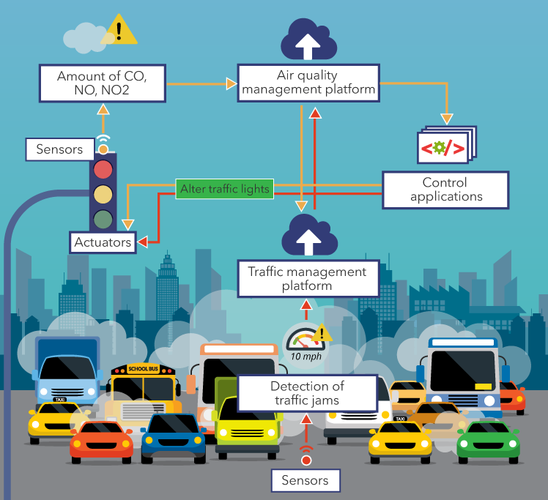
Implementation Considerations for City Management Systems
Assessing current needs and processes to determine the right system fit.
Training staff on how to use the new system effectively.
Ensuring data security and compliance with regulations such as GDPR.
Notes:
Image source: https://solatatech.com/article/iot-for-smart-cities-use-cases-and-implementation-strategies

Slide 6
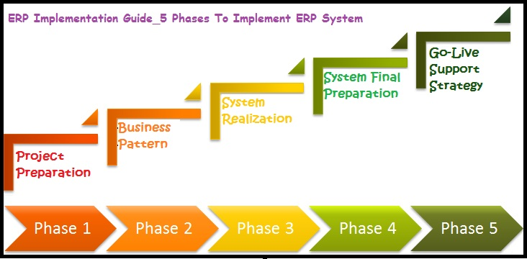
Case Study: City X's Successful Implementation of a Management System
City X implemented a City Management System resulting in 20% cost savings within the first year.
The system improved citizen engagement through online service requests and payments.
City X saw a 15% increase in operational efficiency due to streamlined processes.
Notes:
Image source: http://solutiondots.com/blog/erp-implementation.html

Slide 7
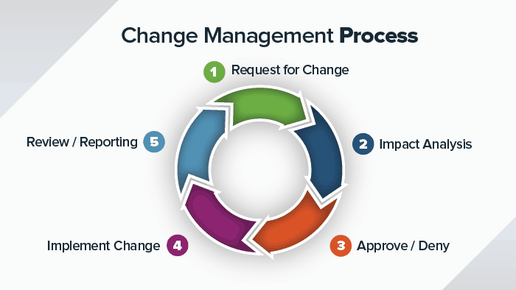
Challenges in Implementing City Management Systems
Resistance to change from staff accustomed to manual processes.
Budget constraints for system procurement and training.
Integration issues with existing legacy systems and data migration challenges.
Notes:
Image source: https://www.smartsheet.com/8-elements-effective-change-management-process

Slide 8

Future Trends in City Management Systems
Increased use of artificial intelligence and machine learning for predictive analytics.
Integration of Internet of Things (IoT) devices for smart city applications.
Enhanced mobile capabilities for on-the-go access to city services and information.
Notes:
Image source: https://bernardmarr.com/the-smart-cities-of-the-future-5-ways-technology-is-transforming-our-cities/

Slide 9
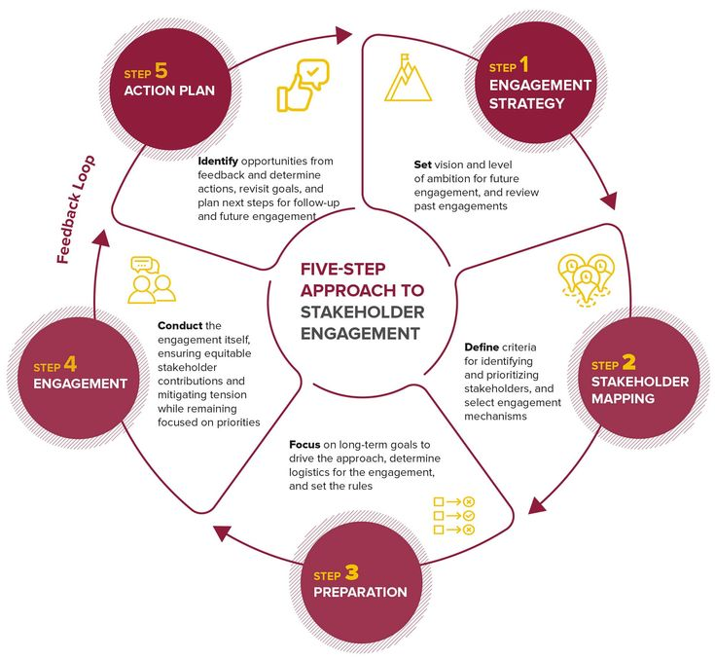
Best Practices for Maximizing the Value of City Management Systems
Engage key stakeholders in the selection and implementation process.
Regularly evaluate system performance and adjust configurations as needed.
Foster a culture of continuous improvement and innovation within the organization.
Notes:
Image source: https://www.pinterest.se/pin/4011087158676355/

Slide 10
ROI Analysis of City Management Systems
Conducting a cost-benefit analysis to quantify the return on investment.
Tracking key performance indicators such as cost savings, process efficiency, and citizen satisfaction.
Demonstrating the value of the system through measurable outcomes and success stories.
Notes:
Image source: https://www.modeladvisor.com/cost-benefit-analysis-a-tool-for-comparing-the-costs-and-benefits-of-different-options/

Slide 11
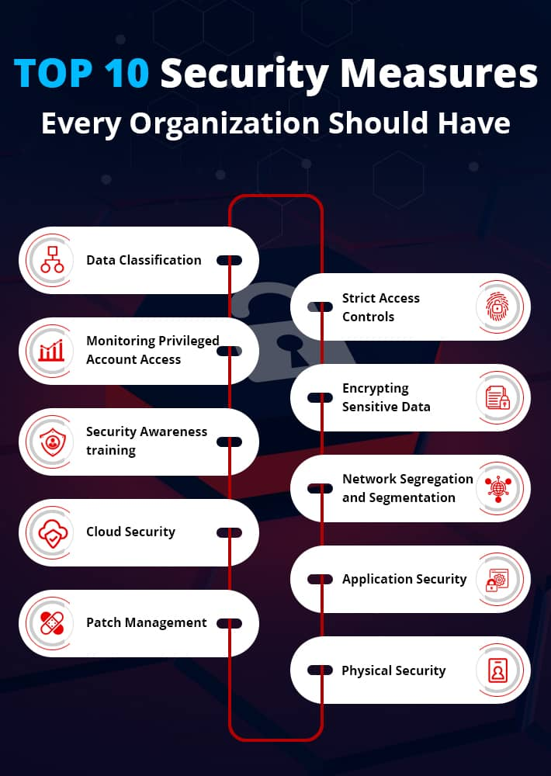
Security Considerations for City Management Systems
Implementing robust cybersecurity measures to protect sensitive data.
Regularly updating software and conducting vulnerability assessments.
Training staff on security best practices to prevent data breaches and cyber attacks.
Notes:
Image source: https://www.lepide.com/blog/top-10-security-measures-every-organization-should-have/

Slide 12

Collaboration Opportunities with City Management Systems
Partnering with other municipalities to share best practices and lessons learned.
Collaborating with technology vendors to co-create customized solutions for specific needs.
Engaging with the community through open data initiatives and participatory decision-making processes.
Notes:
Image source: https://www.wired-for-wealth.com/the-keys-to-successful-collaboration-collaboration-and-teamwork-equals-financial-success/

Slide 13
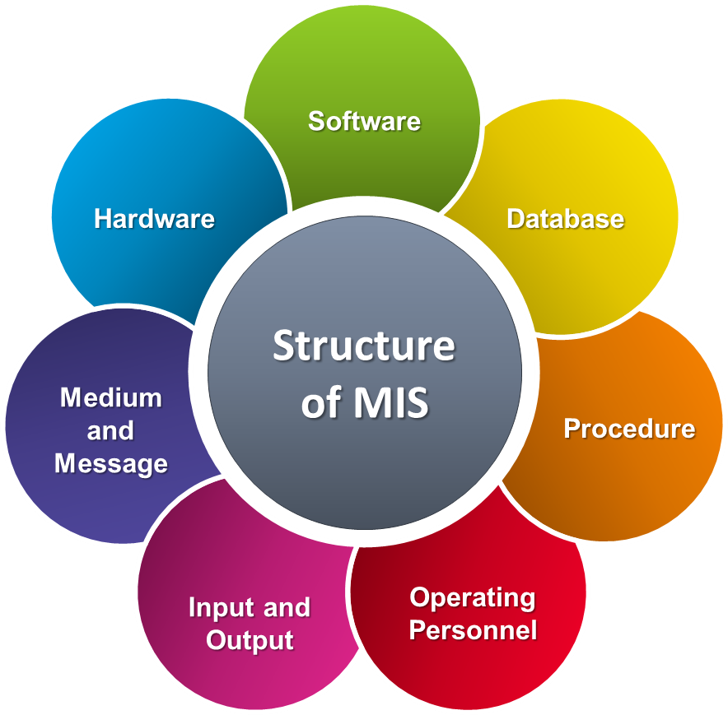
Conclusion
City Management Systems play a crucial role in modernizing local government operations and improving service delivery.
By leveraging technology and data-driven insights, cities can become more efficient, transparent, and responsive to citizen needs.
Investing in a City Management System is an investment in the future sustainability and success of a city.
Notes:
Image source: https://www.fity.club/lists/suggestions/information-systems/

Slide 14
References
"City Management Systems: A Comprehensive Guide," by John Smith, City Management Journal, 2020.
"The Impact of Technology on Local Government Operations," by Jane Doe, Municipal Management Quarterly, 2019.
"Best Practices in Implementing City Management Systems," by Sarah Johnson, Public Administration Review, 2018.

